Slide 1
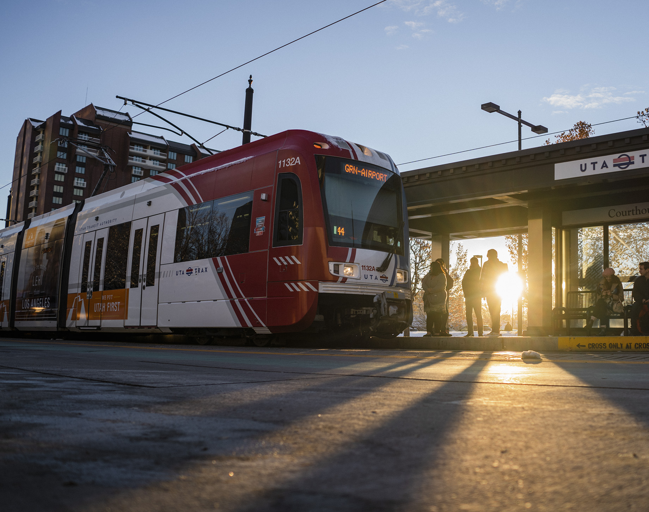
TRAX Ambassador Pilot Program Overview
January 12, 2024

Slide 2
Agenda
Program Overview
Communications Plan
Key Success Measures & Evaluation
Open Discussion and Q&A

Slide 3
Scope

Slide 4
Key Points
What
The TRAX Ambassador includes a team of trained staff who will serve to directly support customers and riders on UTA’s transit system, providing a welcoming and positive environment.
Why
The program is meant to provide support to riders, and particularly to riders experiencing homelessness, including resources, information, and referrals
Meeting riders where they are with information they need.
Who
A team of 6-8 part-time staff with specialized training in working with different communities and the diverse circumstances facing our riding public.
Where
TRAX Blue Line will be the initial implementation of this pilot program. Salt Lake Central Station to Central Pointe Station. Look out for our helpful staff members in the morning and evening hours Monday through Friday.

Slide 5
Eco-system: Community
Community Partnerships
Volunteers of America
Downtown Ambassadors
Salt Lake Coalition to End Homelessness
Salt Lake County
SLC Heart
Park Rangers
Fourth Street Clinic
Odyssey House
Utah Transit Riders Union
Los Angeles Metro
National Transit and Vulnerable Populations Workgroup
Background
Personnel
Evaluation
Training
Public Engagement & Partnerships
UTA Internal
TRAX
UTA Police
FrontRunner, Train Hosts
Customer Service
CS SGR/Ambassador Program
HR/Talent Acquisition
Community Engagement & Travel Training
OAS
Marketing & Communications
Executive Team
Radio Comms/IT
Legal
Customer Experience
Government Affairs
FrontRunner Train Hosts

Slide 6
Training Topics
CPR/First Aid
De-escalation Training
TA-specific Orientation (some in class and some on the system- schedule still being confirmed)
UTA required LMS training
“Ecosystem of Support” for riders, employees, and operations
Radio and device navigation
Emergency protocol
Work & processes (Reporting)
Boundaries Training
Sensitivity Training (working with all riders)
UTA & Community Resources (connecting riders)
Roles & responsibilities
Learning the system: Travel Training presentation/shadowing
What’s missing?

Slide 7
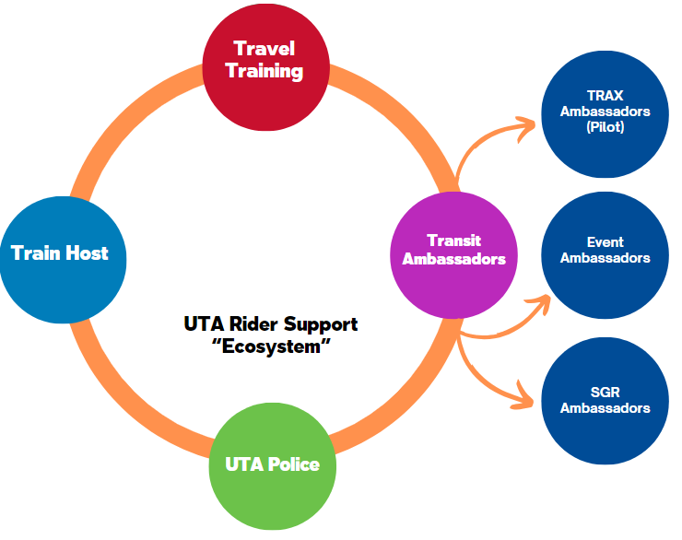
Communications
Website
Social
Press
Transit App

Slide 8
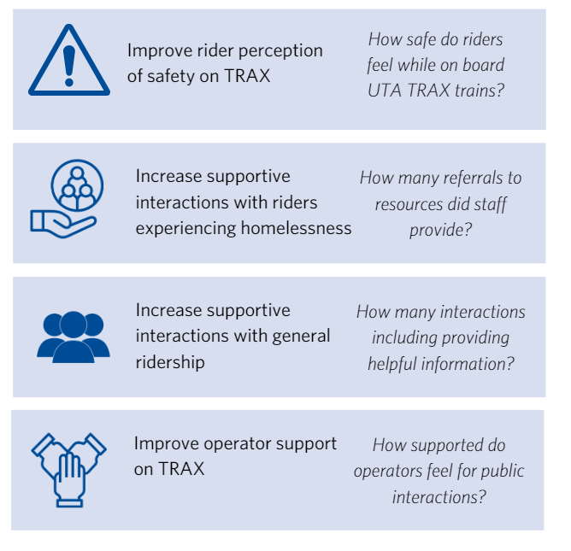
Program Goals

Slide 9
Evaluation Approaches
Question types
Demographic/location-based
Perceptions of Safety and security
Customer information/Rider experience
Pre- & Post-Survey
TRAX Riders
TRAX Operators
Data Collection & Reporting Ongoing
Interactions
Incidents
Referrals for resources
What’s missing
Public engagement and key stakeholder interactions

Slide 10
Q&A and Open Discussion

Slide 11
Invitation
We’d love to keep you involved as partners on this pilot program.
We will be sending out periodic updates and invitations to check in – if you know anyone else that would be interested in joining us, please let us know.

Slide 12
Contact Us
Megan Waters
mwaters@rideuta.com
801-244-3271
Doraleen Taulanga
dtaulanga@rideuta.com
801-448-4666

